Slide 1
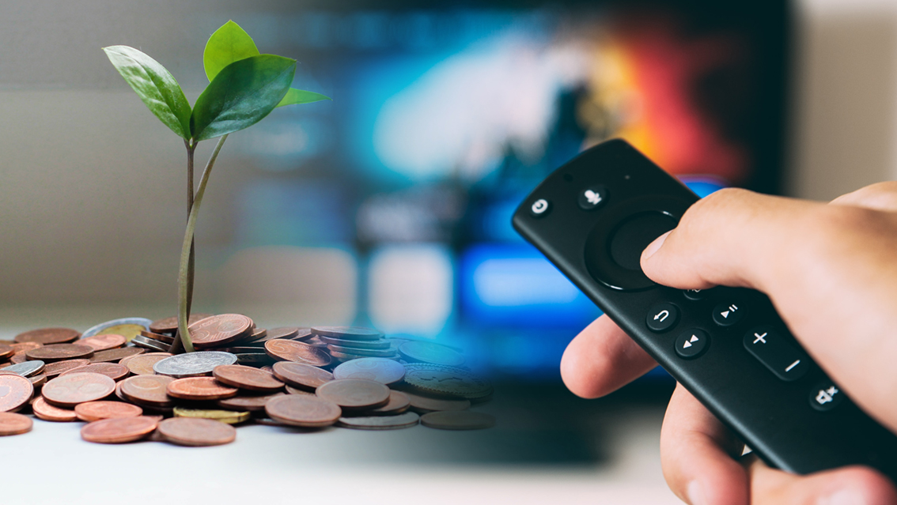

The Global TV Deck
TV drives business outcomes
May 2021

Slide 2
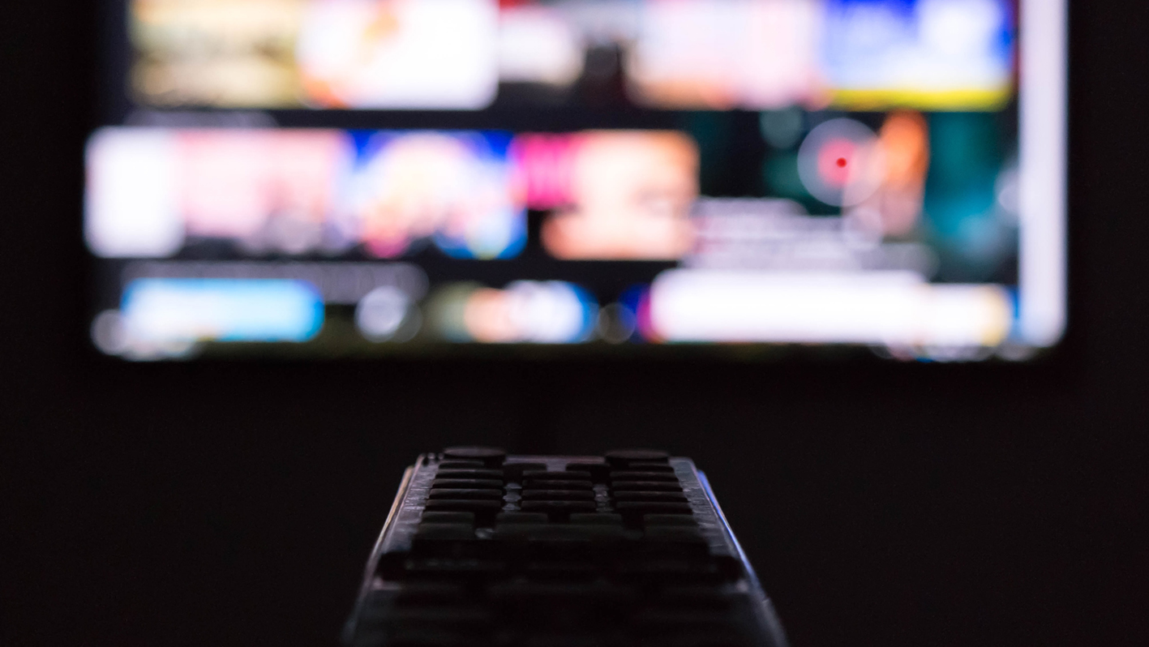



“Advertisers choose TV for the most important role in their marketing plans, that of ‘lead outcomes-driver’. To best achieve the full range of business results - from quickly activating customer traffic at scale to securing brand loyalty beyond reason, whatever is most mission-critical to sales goals and brand goals should be trusted to TV.”
--- Sean Cunningham, President of The Global TV Group and CEO & President of the VAB
“Globally we have different customers with different objectives: Sales, activation, aiming for short or long-term results etc.. The wonderful result of our joint research expertise is that TV meets all these goals – everywhere.”
--- Martin Krapf, Vice-President of The Global TV Group and Non-Executive Board Member of Screenforce Germany
“There’s an increasing culture of effectiveness in marketing. Outcomes are in. So, this new deck is timely. It shows repeatedly, forensically and comprehensively TV advertising’s incredible skillset. It demonstrates how TV solves business problems and is packed with the evidence marketers need to prove that TV is a low-risk investment that unlocks growth.”
--- Lindsey Clay, Past President of The Global TV Group and CEO of Thinkbox

Slide 3
TV offers:
The strongest contribution to sales
The strongest contribution to both long-term and short-term ROI
The strongest halo effect on other media
The best option for recovery in times of crisis
The highest quality of contacts due to attention levels
The highest impact on awareness, consideration and purchase intent
The largest scale, a driver of effectiveness
The ideal balance between branding, short-term sales and long-term business outcome
The highest profit at the greatest efficiency, and with the least risk
The best guarantee for market share growth
Measurable results across all life stages of a brand
Immediate increases in website traffic, particularly for direct-to-consumer brands

Slide 4

TV remains the strongest contributor to sales demand
Executive summary/key results
Title of the study:
Can TV Generate Sales Demand?
Year of publication: 2017-2021
Commissioned by: ThinkTV Australia
Contractor: GroupM, Gain Theory, D&D Consultants
Total TV drives 3x greater sales volume than any other medium
Total TV remains the strongest contributor to long-term ROI
Total TV is fundamental to the sales demand derived from search contributing 18% towards the sales impact
TV has the greatest synergistic effect, providing the highest lift in the performance of other channels

More information
AUSTRALIA

Slide 5
Total TV is in its own (good) place
with strong short and long-term ROI
Long-term ROI
Source: Can TV generate demand?, ThinkTV Australia, Feb 2021
AUSTRALIA

Slide 6
Total TV drives 3x more sales volume
than any other medium
Not only does Total TV deliver great ROI in the short and long-term, but
Total TV also drives 3x greater sales volume than any other medium
Total TV
OOH
Radio
Search
Digital
display
Print
Social
(Facebook)
Digital video
Cinema
Effectiveness Index
Source: Can TV generate demand?, ThinkTV Australia, Feb 2021
AUSTRALIA

Slide 7

TV increases ROI, provides long-term results
and drives effectiveness
Executive summary/key results
Title of the study:
TV Drives Advertising Effectiveness that Lasts
Year of publication: 2019, 2021
Commissioned by: thinktv Canada
Contractor: Accenture
TV’s attributed sales ROI is higher than other media
TV has a significant halo effect on other media, especially digital:
TV increases digital’s ROI by 19%
Multiplatform TV has the longest-lasting impact on sales
TV’s resilience to diminishing returns highlights the upside of increasing investment

More information
CANADA

Slide 8






TV delivers the best ROI
TV’s ROI is
$14.34 for every dollar spent
Source: Canadian Media Attribution Study
CANADA

Slide 9
TV delivers the best ROI
In the
long-term,
TV’s ROI grows to $23.40
TV
Display & Other
Search
Social
Short-form video
Other Media
Source: Canadian Media Attribution Study
CANADA

Slide 10

TV improves digital’s performance
TV has a significant halo effect on digital media, increasing its sales ROI by 19%
Without TV’s
halo effect, digital advertising’s average ROI would decline by 19%
Standalone Digital ROI
TV’s Adjusted ROI
-19%
+23%
Source: Canadian Media Attribution Study
CANADA

Slide 11

TV has the highest contribution to sales
among all media
Executive summary/key results
Title of the study: The Effectiveness & ROI of TV advertising
Year of publication: 2019
Commissioned by: SNPTV
Contractors:
CSA, data2decisions, Dentsu Aegis, Groupm, annalect/Omnicom, Publicis media
TV triggers
65% of the media sales impact
TV is by far the leader in carry-over effects
TV boosts the
other media performance,
amplifying their sales effects
TV is by far the leader in terms of long-term advertising effects

More information
FRANCE

Slide 12
TV has higher contribution to sales than other high-ROI media
Size of the bubbles in proportion to the contribution to sales
Source: The Effectiveness & ROI of TV advertising, SNPTV/CSA, data2decisions, Dentsu Aegis, groupm, annalect/Omnicom, publicis media,2019
FRANCE

Slide 13
TV has the biggest long-term sales effect among all media
Size of the bubbles in proportion to the contribution to sales
Source: The Effectiveness & ROI of TV advertising, SNPTV/CSA, data2decisions, Dentsu Aegis, groupm, annalect/Omnicom, publicis media,2019
FRANCE

Slide 14
TV is an essential medium to support brand’s economic recovery
Executive summary/key results
Title of the study:
How to boost a brand’s recovery with tv advertising?
Year of publication: 2020
Commissioned by: SNPTV
Contractor: Ekimetrics
Even in the short-term,
TV has the best ratio between contribution to sales and ROI
TV’s saturation threshold is much higher than that of other media
The effects of TV are immediate and last much longer than any other media
Due to its unequalled reach, TV creates strong synergies with other media
TV is an essential media to boost all marketing levers: contribution to sales, ROI and impact other media’s capacity to sell

More information
FRANCE

Slide 15
TV advertising is an essential tool for brands
in times of economic recovery
MMM study conducted by Ekimetrics (150 brands – 5 different sectors – 6 years of historical data)
Contribution to sales
44%
ROI
5.2
For each 1€ invested
Saturation level
Up to
4x higher compared to other media
Synergy
+15% to 40%
effectiveness on other media sales
Source: How to boost a brand’s recovery with TV advertising?, SNPTV/Ekimetrics, 2020
FRANCE

Slide 16
Television and online video have an unsurpassed contribution to sales and ROI ratio
MMM study conducted by Ekimetrics (150 brands – 5 different sectors – 6 years of historical data).
Size of the bubbles in proportion to the size of investments
Global ROI in €
(> 4 months)
44% contribution to sales
5.2 ROI
32% share of investments
% contribution to sales
Source: How to boost a brand’s recovery with TV advertising?, SNPTV/Ekimetrics, 2020
FRANCE

Slide 17






TV creates strong synergies with other media
that boost impact on sales
MMM study conducted by Ekimetrics (study based on 150 econometric models over 6 years 2014 to 2015 – 5 different sectors: automotive/banking & insurance/premium cosmetics/food retail/consumer products)
Matrix of synergies offered by TV in the 5 sectors
Automotive
+
Radio
VOL
OOH
+15% to + 40% overperformance of ROI
TV’s ROI reaches 6.1€
(for every € invested) for
all included sectors
Synergy:
measure of how activating TV increases efficiency on other media sales
Bank & insurance
+
Radio
Radio
OOH
Premium cosmetics
+
Radio
OOH
Social/VOL
PGC
+
Radio
Display
VOL
Food retail
+
Radio
OOH
Radio
Source: How to boost a brand’s recovery with TV advertising?, SNPTV/Ekimetrics, 2020
FRANCE

Slide 18
TV strengthens Facebook but not vice versa
Executive summary/key results
Title of the study:
MEDIENÄQUIVALENZSTUDIE 1 UND 2
Year of publication: 2018, 2020
Commissioned by: Google and SevenOne Media (2018), SevenOne Media (2020)
Contractor:
Facit (Serviceplan Group)
While video ads work on every platform, linear TV brings the highest impact on results
TV strengthens Facebook but not vice versa:
ads on digital platforms benefit from a combination with linear TV campaigns
Corner placements and bumper ads are the most effective ad placements

More information
GERMANY

Slide 19
TV and BVOD scale at high level
and up to high contact levels
Base:
Meta modelling per channel - Model quality: MAPE (aggregated) = Mean Absolute Percentage Error = 11.8%
TV and BVOD not only generate the highest effectiveness levels, but they also have increasing impact even at high contact stages
Unaided advertising recall: monomedial impact curves
In %
Source: Media Equivalence Study: Video, Media Equivalence Study, Video Contact+, Facit
GERMANY

Slide 20
YouTube cannot replace TV contacts
Unaided advertising recall: 4 exposures
In %
TV content provides the most effective environment. With each TV exposure replaced by YouTube, impact declines
Source: Media Equivalence Study: Video, Media Equivalence Study, Video Contact+; Facit
GERMANY

Slide 21
Total Video, regardless of device, drives more sales uplift than any other platform
Executive summary/key results
Title of the study:
Not All Reach is Equal
Year of publication: 2020
Commissioned by: Screenforce
Contractor: Amplified Intelligence (prof. Karen Nelson-Field)
TV and BVOD, regardless of device, drive more sales uplift than YouTube, Instagram and Facebook
Even 28 days after ad exposure the impact of Total video is higher than ads impact on the first day on other platforms
Viewability matters:
Low ad pixels decreases the level of attention and thus the likelihood of a brand being selected

More information
GERMANY

Slide 22


Advertising on TV platforms generates the highest short-term advertising strength (STAS) and aided recall
STAS by media channel
Figures as index
AIDED Advertising recall by media channel
Figures in %
TV | 129
BVOD |  | 138
YouTube |  | 112
Instagram |  | 105
Facebook |  | 100
TV | 28
BVOD |  | 23
YouTube |  | 18
Instagram |  | 16
Facebook |  | 16
Reading example: The purchase intention for the advertised brands is 29 percent higher after exposure to TV advertising than without advertising exposure.
Reading example: After exposure to TV advertising 28 percent can remember the advertised brands.
Source: Not all reach is equal, Screenforce/Amplified Intelligence, 2020
GERMANY

Slide 23
TV’s advertising impact remains strong over time
● BVOD | — Power (BVOD)
● TV on TV screen | — Power (TV on TV screen)
● YouTube on mobile | — Power (YouTube on mobile)
● Facebook on Mobile | — Power (Facebook on mobile)
Short-term advertising strength (STAS) over time
Figures as index
To determine the advertising impact, STAS compares purchases with and without advertising contact
138
129
115
112
114
100
99
92
0
4
8
12
16
20
24
28
Source: Not all reach is equal, Screenforce/Amplified Intelligence, 2020
GERMANY

Slide 24
The ROI effects of TV investments last 5 years or more
Executive summary/key results
Title of the study: ROI Analyzer
Year of publication: 2013-2018
Commissioned by:
Seven.One Media, Screenforce (since 2015)
Contractor: GfK
Stable effect of TV advertising: even in the third wave,
TV still achieves comparable short- and long-term ROI
Strong effects under the brand umbrella:
brands with an umbrella brand structure achieve higher ROI
Even high investments in TV advertising are efficient:
every purchase counts
Brands that are bought more often achieve higher ROI.
Big brand, big impact:
TV advertising by big brands is more efficient
Creation matters:
consistent use of creative pays off
Segment-specific mechanisms: Confectionery products achieve higher short-term ROI, cosmetics products are strong in the long term

More information
GERMANY

Slide 25
ROI remains at a high level
Basis: 318 campaigns (FMCG 2011/2012: 204, Confectionery & Cosmetics 2014: 43, FMCG 2017: 71).
Shown is the net ROI (flat estimate of net investments based on Nielsen Media Research, ZAW).
Short- and long-term ROI in the 3 surveys
Ratio of additional revenues from advertising to net TV spendings
Ø 2,60
Ø 1,13
Source: SevenOne Media, Screenforce, GfK
GERMANY

Slide 26

Mass-reach campaigns have a larger impact on sales than moderate ones (regardless of brand size)
Executive summary/key results
Title of the study: How does TV’s reach impact sales?
Year of publication: 2020
Contractor: Kantar
Mass reach ad campaigns (with an av. 88% coverage) have a
4% contribution
to brand sales
----------------------------------------
which is
10 times higher
than
moderate campaigns
(with a 47% av. coverage).
34% is the minimum coverage
needed for a campaign to
have an impact on buyers and on a brand’s sales
Campaigns with a 70% - 90% coverage deliver the
best possible impact
in terms of contribution to sales and penetration

More information
SPAIN

Slide 27
Mass reach campaigns have a larger impact on sales than moderate ones (regardless of brand size)
Average contribution to sales of the various marketing Mix levers |
3 periods (2 campaign flights + 1 rest period)
--------------------------------------------
TV’s contribution to sales of brands that do mass reach campaigns is
9.5 times higher
than in the case of brands with moderate campaigns
x 9.5
Source: Kantar, 2020
SPAIN

Slide 28
The larger the coverage, the greater TV’s contribution to brand sales, (regardless of brand size and campaign budget)
Average % of TV’s contribution to sales per brand groups based on brand’s billing periods (2 campaign flights + 1 rest period).
x 10
x 15
x
4
x
7
Source: Kantar, 2020
SPAIN

Slide 29
TV creates sales uplifts for brands even at low investment levels
Executive summary/key results
Title of the study: As seen on TV
Year of publication: 2019
Commissioned by: Thinkbox
Contractor: Data2Decisions
There are
three main triggers that signal an advertiser is ready to move into TV:
diminishing returns, scaling up, build brand/brand awareness
Scale is the biggest driver of effectiveness
Advertising has both
a short-term and a sustained effect on sales
The point of diminishing returns needs to be identified
Strategies that harness the benefits of TV but at lower cost can work well as a starting point
Advertisers should start TV with a shorter, high impact burst strategy
rather than a smaller, continuous drip approach

More information
UNITED KINGDOM

Slide 30
TV creates sales uplifts for brands even at low investment levels
Smaller brands see the biggest uplifts in sales when using TV campaigns
-----------------------------------------
TV has a stronger proportional effect for smaller brands – showing the power of TV to help build the brand. This is because small brands are working from a lower base and TV gets advertisers seen, heard and talked about quickly
Source: As seen on TV, Thinkbox/Data2Decisions, 2019
UNITED KINGDOM

Slide 31
TV performs better than any pure ‘demand-generating’ channel (both in short- and long-term)
Executive summary/key results
Title of the study:
Demand Generation
Year of publication: 2019
Commissioned by: Thinkbox
Contractors:
Mediacom, Wavemaker, Gain Theory
58% of advertising’s profit return is overlooked when ignoring the long term
Some forms of advertising are riskier than others
Most advertising channels boost the efficiency of others, but the scale and consistency of the effect differs significantly
Marketing budgets tend to be used to do two things: demand generation and
demand fulfilment
Within the first fortnight of a campaign,
TV delivered on average 23%
of media driven sales
We need to
put measurement right!

More information
UNITED KINGDOM

Slide 32
TV’s short- and long-term effect means
it generates the best volume overall
Different media drive sales impact over different timescales.
--------------------------------------
TV makes the most significant impact on media-driven sales, delivering in the first weeks of a campaign but also in the following two years after investment.
Source: Demand generator, Thinkbox/Mediacom,/Wavemaker/Gain Theory, 2019
UNITED KINGDOM

Slide 33
TV advertising delivers the highest profit at the greatest efficiency, and with the least risk
Executive summary/key results
Title of the study: Profitability: the business case for advertising
Year of publication: 2018
Commissioned by: Thinkbox
Contractor: Ebiquity, Gain Theory
Advertising is a powerful
business investment
It’s time to reassess the return that advertising can generate
Advertising profit isn’t just about ROI but volume and scalability
TV delivers scale of return
Advertising-generated profit varies by category
TV delivers 71% of total profit generated by advertising, at the greatest efficiency, and for the least risk
Advertising can be risk assessed

More information
Source: Kantar, 2020
UNITED KINGDOM

Slide 34
TV advertising delivers the highest profit at the greatest efficiency, and for the least risk
Looking at the combined short and long-term effects of advertising,
TV delivers 71% of total advertising-generated profit over 3 years despite TV currently commanding 54% of average advertising budget.
-----------------------------------------
Bubble size represents
% of total profit
Total profit =
all return (short + long-term) generated over 3 years
Proportion of advertising-generated profit by medium
TV: 71%
Print: 18%
Online Video: 4%
Radio: 3%
OOH: 3%
Online
Display: 1%
Source: Profitability: the business case for advertising, Thinkbox/Ebiquity/Gain Theory, 2018
UNITED KINGDOM

Slide 35
Investing in advertising during the recession, is ultimately worth the long-term profit
Executive summary/key results
Title of the study:
Advertising in recession – Long, Short or Dark? A guide to advertising best practice in recession
Year of publication:
Update: 2020 (Original Study: 2009)
Commissioned by: Peter Field
Contractor: IPA (original study)/ B2B Institute (update)
“Going dark”
(ie. stopping advertising)
during an economic crisis is very risky and it can take up to five years for brands to recover
A recession is no time to switch solely to short-term sales activation, because
brand-building is what is going to see brands through recovery
Brands, who continue investing in advertising during a crisis, may be able to increase their SoV and SoM for cheaper,
since the prices of advertising are lower in recession
Brands who saw the crisis as an opportunity (with over 8% ESoV), saw over 2.5 times as many large business effects and 4.5 times the annual market share in times of recovery.
Opportunists experienced strong profitability growth in recovery

More information
Source: Kantar, 2020
UNITED KINGDOM

Slide 36
Investing in SoV drives strong growth during recession
Base: IPA cases covering 2008 recession
Source: Advertising In a Downturn, Peter Field/IPA, 2009
UNITED KINGDOM

Slide 37
Investing in SoV during recession drives long-term profit growth
Base: IPA cases covering 2008 recession
Source: Advertising In a Downturn, Peter Field/IPA, 2009
UNITED KINGDOM

Slide 38
Successful advertisers ensure their campaigns strike the right balance between long-term and short-term investments
Executive summary/key results
Title of the study:
Advertising Effectiveness: the long and short of it
Year of publication: 2012
Commissioned by: Les Binet and Peter Field
Contractor: IPA
There is a tendency to use very short-term online metrics as primary performance measures and this has dangerous implications for long-term success
Long-term (3+ years) investment in advertising delivers double the profit of a short-term approach (less than 1 year), but investing in both delivers even higher returns
Brands which target the whole market achieve 3 times as many large business effects than those that focus on existing customers
TV advertising remains the most effective way to build a brand and creates larger business effects than other forms of advertising
Advertisers need to ensure their campaigns strike the right balance between long-term investment in brand-building and short-term, direct methods that stimulate sales (60:40 principle)

More information
UNITED KINGDOM

Slide 39
Brand building and sales activation work over different timescales
Brand building and activation effects are not generated by marketing campaigns in the same way across time. This chart illustrates why it is easy to end up overdoing short-term activation measures if you are in a business environment that values short-term results.
Sales activation:
Short-term sales uplifts
Brand building:
Long-term sales growth
Sales uplift over base
Time
Short term effects dominate - 6 months
Source: Les Binet and Peter Field, Media in Focus: Marketing Effectiveness in the Digital Era, IPA, 2013
UNITED KINGDOM

Slide 40
TV is best for market share growth
Source: IPA Databank, 2014-2016
UNITED KINGDOM

Slide 41
The broader the reach, the broader the effects
Average number of very large business effects reported
Source: Advertising Effectiveness: the long and short of it, Peter Field/Les Binet/IPA, 2012
UNITED KINGDOM

Slide 42
TV is a growth engine that drives measurable results across all life stages of a brand
Executive summary/key results
Title of the study:
The Halo Effect: Tv As a Growth Engine
Year of publication: 2020
Commissioned by: VAB & Effectv
Contractor: VAB & Effectv
Both direct-to-consumer (DTC) and non-DTC brands across all life stages saw an immediate double-digit increase in unique visitors to their digital platforms during their TV launch month
Younger brands (three years or less) see the largest impact of TV
as they are establishing their story and identity in market
The longer that younger DTC brands are active on-air the higher their digital engagement as additional consumers are exposed to the brand and messaging

More information
UNITED STATES

Slide 43
TV drives immediate increases in website traffic among direct-to-consumer brands, particularly younger ones
The younger DTC brands saw the largest impact from their TV launch month, with the largest website traffic lifts on average
------------------------------------------------------
How to Read:
DTC brands that are three years old or younger saw a +23% lift in their website traffic during their TV launch month vs. their three-month average website traffic prior to TV.
------------------------------------------------------
By the nature of their business model, DTC brands have had a digital media presence since near inception, so these increases are in the context of existing digital advertising pre-TV launch
Direct-to-Consumer Brands: TV Launch Month* vs. Three-Month Average Prior To TV
Average Website Unique Visitors
Three Years Old or Younger
Between Four –
Seven Years Old
Eight Years or Older
+23%
+19%
+10%
Unique visitors % increase
Source: The Halo Effect: TV as a Growth Engine, VAB, 2020
UNITED STATES

Slide 44
As DTC brands continue advertising and build a sustained presence on TV, younger brands see even greater lifts in digital conversions to their website
How to Read:
DTC brands that are three years old or younger saw a +138% lift in their average monthly website traffic when they were airing on TV vs. their three-month average website traffic prior to TV.
Direct-to-Consumer Brands: ‘When On TV’ Monthly Average vs. Three-Month Average Prior To TV
Average Website Unique Visitors
Three Years Old or Younger
Between Four – Seven Years Old
Eight Years or Older
+138%
+72%
+23%
Average Monthly
Unique Visitors % increase:
+811K
+1 383K
+803K
Source: The Halo Effect: TV as a Growth Engine, VAB, 2020
UNITED STATES

Slide 45
TV offers:
The strongest contribution to sales
The strongest contribution to both long-term and short-term ROI
The strongest halo effect on other media
The best option for recovery in times of crisis
The highest quality of contacts due to attention levels
The highest impact on awareness, consideration and purchase intent
The largest scale, a driver of effectiveness
The ideal balance between branding, short-term sales and long-term business outcome
The highest profit at the greatest efficiency, and with the least risk
The best guarantee for market share growth
Measurable results across all life stages of a brand
Immediate increases in website traffic, particularly for direct-to-consumer brands

